Slide 1
Endangered animals in Finland “Animal is endangered, if the animal have a risk to disappear for keeps”. In Finland we have 2 124 endangered species.

Slide 2
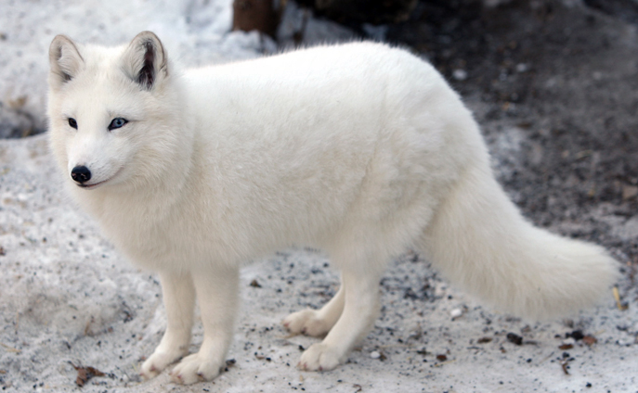
Arctic fox: Predatory animal of the canine.
Number of species: 215

Slide 3
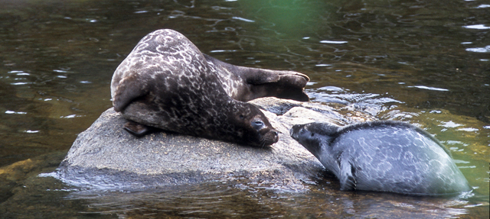
Saimaa ringed seal: Seal who only lives in Finland.
Number of species: 320

Slide 4
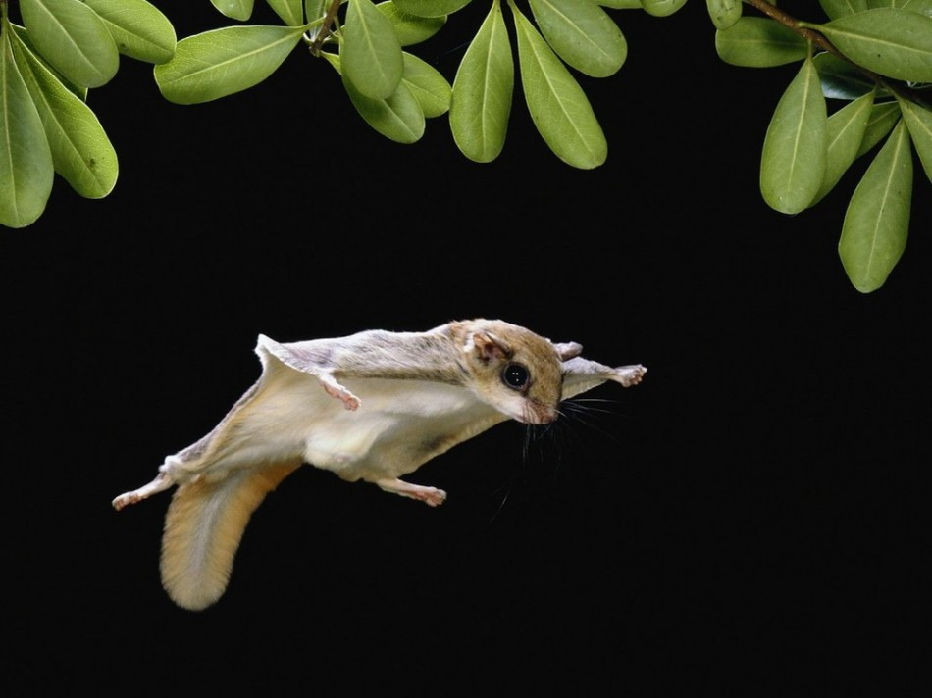
Flying squirrel: Rodent species found in the north-Eurasian region.
Number of species: 50 000 - 100 000

Slide 5
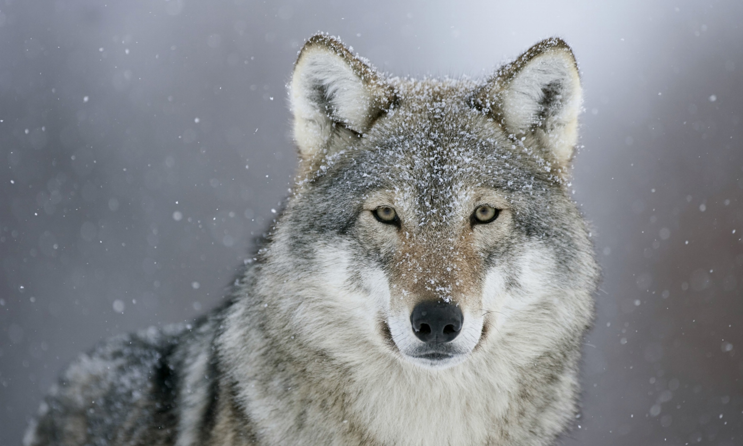
Wolf: Predator who reminds dog.
Number of species: 220-245

Slide 6
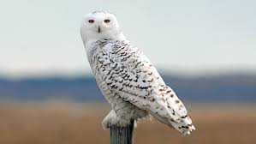
Snowy owl: Big sized owl who lives in the Arctic regions.
Number of species: 100-200

Slide 7
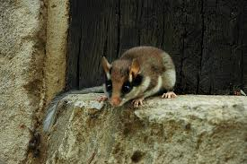
Garden dormouse: Really rare rodent.
Number of species: Not sure but almost lost.

Slide 8
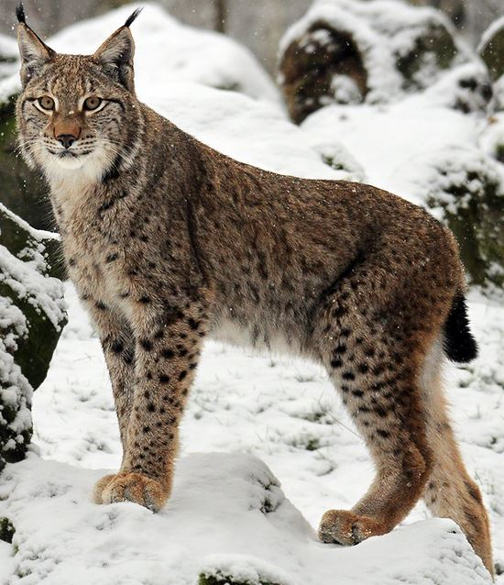
Lynx: Medium feline who lives in Eurasia.
Number of species: 2700-2800

Slide 9
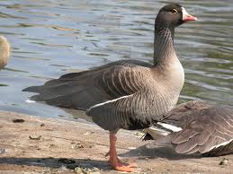
Lesser white-fronted goose: The most endangered goose in Eurasia.
Number of species: 20-40

Slide 10
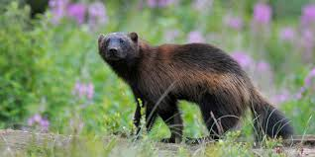
Wolverine: The largest marten who is predatory animal.
Number of species: 230-250

