Slide 1
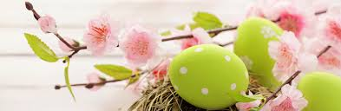
EASTER

Slide 2
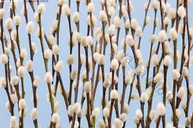
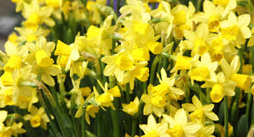
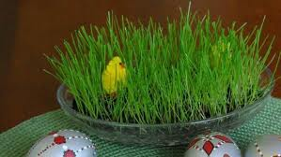
PLANTS
We bring in willow branches, beacause it’s the only plant in the north that is in bloom during easter.
Easter is a happy holiday and one of it’s most important colours is yellow, so we also bring in yellow narcissus.
Quickly growing grass that we grow inside symbolizes the spring awakening.

Slide 3
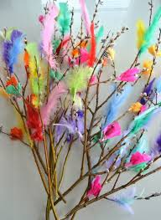
WILLOW BRANCHES
In easter kids decorate willow branches, go door to door dressed like witches and say a short poem in exchange for candy and chocolate easter eggs.
They are decorated with feathers, paper stripes and small plastic easter eggs

Slide 4
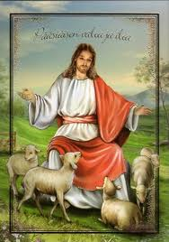
EASTER IS A CHRISTIAN HOLIDAY
Easter celebrates the resurrection of Jesus.
It’s the oldest and the most important Christian holiday.
Going around from door to door with willow branches has been a tradition, where the person expels bad spirits and wishes good luck and health.
Willow branches symbolise the palm leaves that the people threw on the road when Jeesus rode past them.

Slide 5
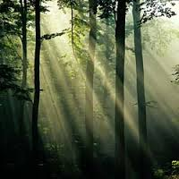
EASTER AND THE NATURE
Easter also celebrates the light increasing in the nature.
Many of the decorations are taken from the forests, like willow branches and all paper decorations.
Rabbits live in the forest and they are a symbol to birth and life.

Slide 6
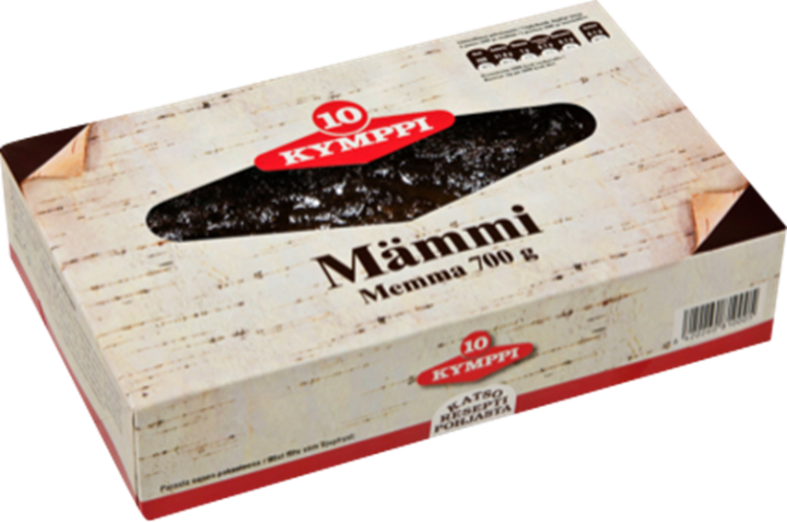
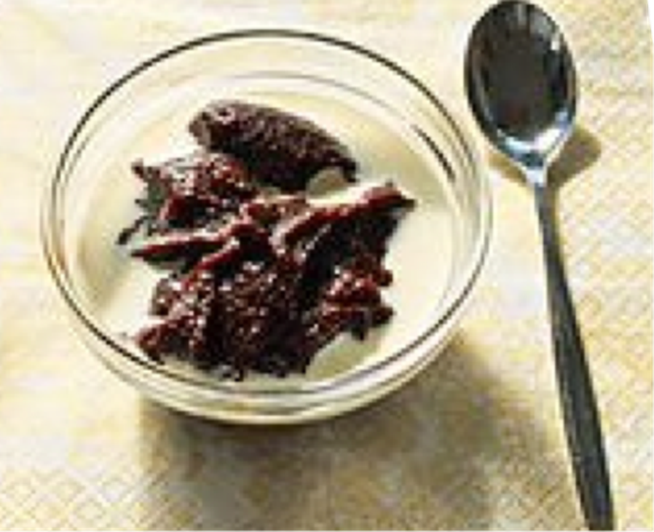
FINNISH EASTER PUDDING
Finnish: Mämmi
Traditional Easter dish.
Made of water, flour and malt.
Nowadays we eat Finnish Easter pudding cold with sugar and milk or cream.
Today Finnish Easter pudding replaces the ancient sour bread.
Additives and preservatives are forbidden.

Slide 7
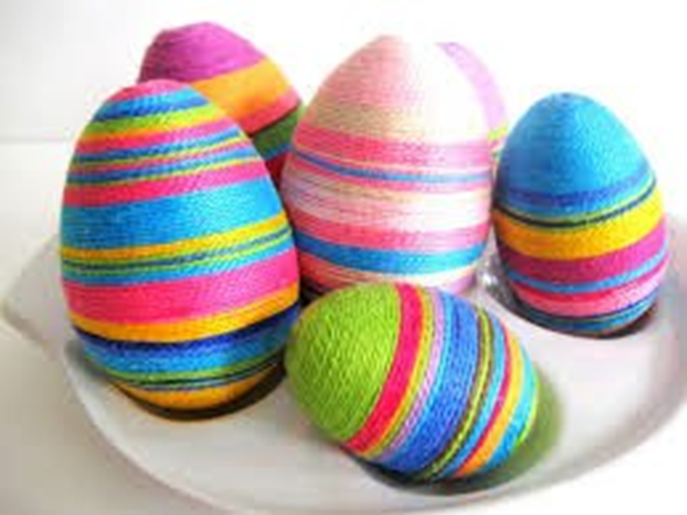
EASTER EGGS
Easter egg is known as a symbol of fertility and growth.
Eggs are decorated.
In Finland eggs are hidden and children are looking for them.

