Slide 1
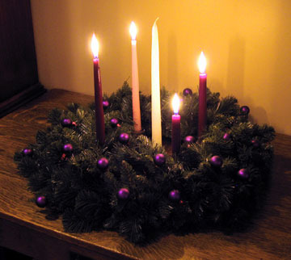
Lucia’s day
Is celebrated in honor of the Holy Lucia of the 13th December

Slide 2
Holy Lucia
Means whitelighter
Was martyred during Emperor Diocletianus’s kingdom
A Patron saint of the blind and visually impaired
She belonged to Christianity
Brings light to the people and the dark forests of the North

Slide 3
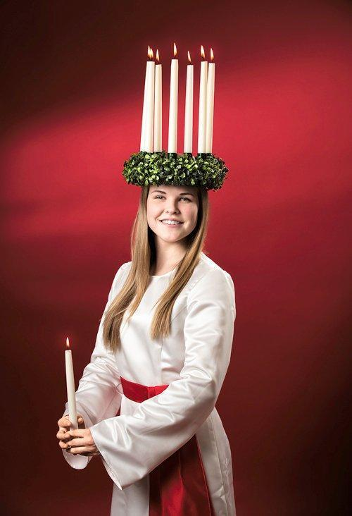
Lucia’s clothes
Lucia wears a white costume
A Red belt
In her head, she carries the candle wreath, which is made of lingonberry twigs
A Candle in hand

Slide 4
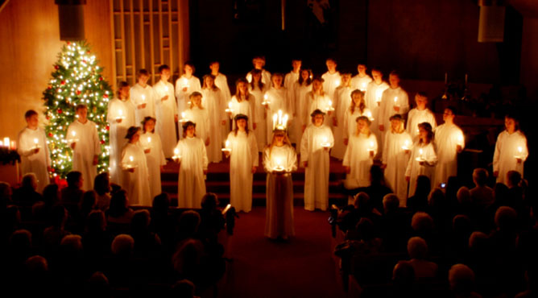
Santa Lucia song
Lucia sings with choir
They go to sing in hospitals, nurseries, elderly homes and schools

