Slide 1
Lucía Rueda 1ºA (53)
The secrets of forests I have chosen this photo because it conveys cleaning, order and nature.

Slide 2
PHOTOCONTEST
THE SPIRIT OF THE FOREST
IES CARLOS III – SPAIN

Slide 4
Jesús Rueda Checa 4ºA (86)
The depth of an apple
Only a bite of an apple can teleport you to the depth of a forest

Slide 6
Paola de Lara López 3ºA (127)
Don ́t Forget Where You Belong
Nature is our real mum and forests are our real homes.
What shall we do without forests? Yes,I know that technologies allows us to do everything nowadays, and they are going to continue improving, but, without nature, they wouldn’t exist. In spite of this, we can ́t stop killing our "mum", and breaking our real house. How are we alive? Thanks to nature.
We shouldn ́t forget our origins.

Slide 7
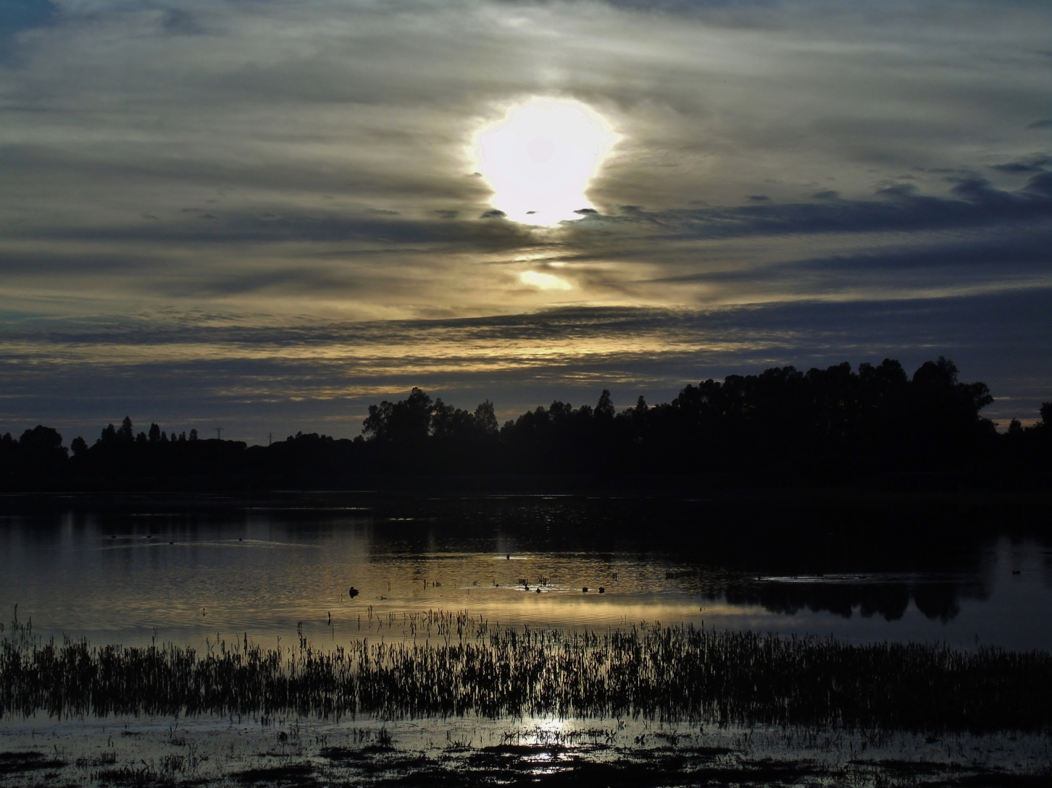

Slide 8
Beatriz Yoldi Martín-Calpena 4ºC (109)
ROOTS OF MISTERY
Roots of the past and roots of the present, all connected by the same land.
Some are still alive, part of a tree , essential to be alive.
They remind me of my family and ancestors, they have made me possible and some of them that are here with me now.

Slide 10
Candela Rousseau Cañadas 4ºC (8)
ENIGMA OF FOREST
The trees in the huge, deep, dark forest, shake, swish their leaves like foil wrapper. The wily wind, wriggling through their crowns, rustling that soon starts. Trees know. And the whole forest is ready.

Slide 12
Priscila Semanche 1ºC
WINDING BRANCHES
Relaxing in the forest. Mysteries unsolved. Remembering my loved ones.

Slide 13
