Slide 1
Trip to Holland
16/11/2014 to 22/11/2014
Portuguese students

Slide 2
First Day
Flight to Holland

Slide 3
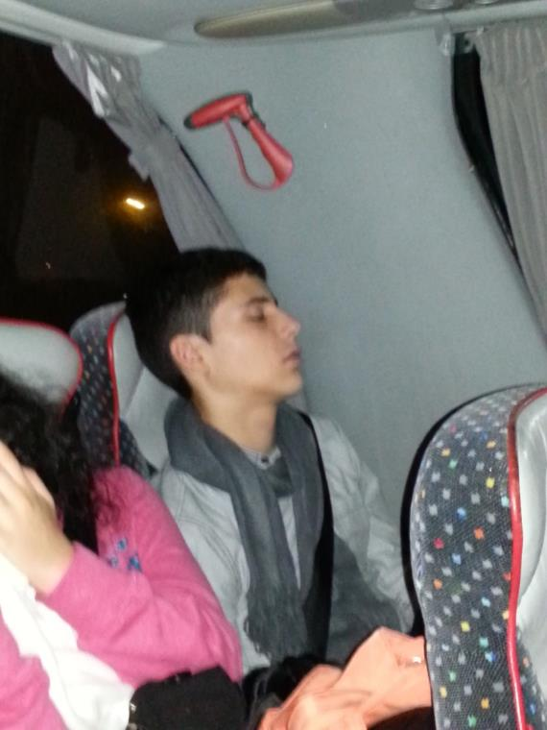
Trip to Lisbon’s airport
We left Coimbra at 2:15 am and went by bus to Aeroporto da Portela, in Lisbon. We got there at 4:30 am.

Slide 4
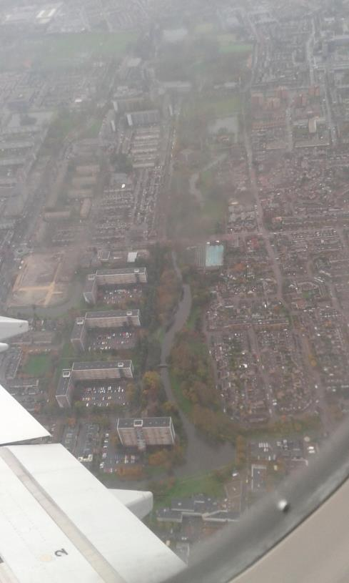
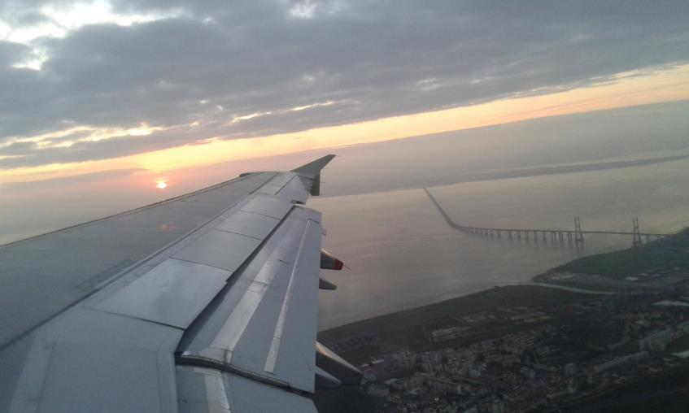
Flight to Amsterdam
Our flight left at 7:30 am and took 2:50 hours to get to our destination.
Still in Lisbon…
Arrival ☺

Slide 5
In Amsterdam’s airport

Slide 6
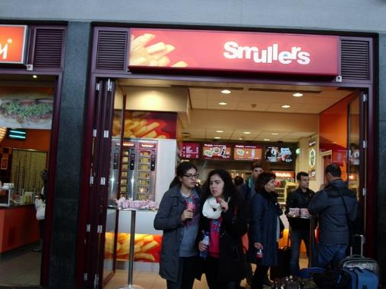
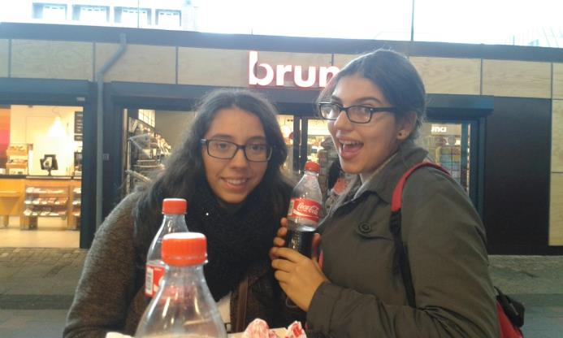
From Amsterdam to Tilburg
We went by train from the airport to Tilburg. When we got to the train station we had lunch in a fast food restaurant.

Slide 7
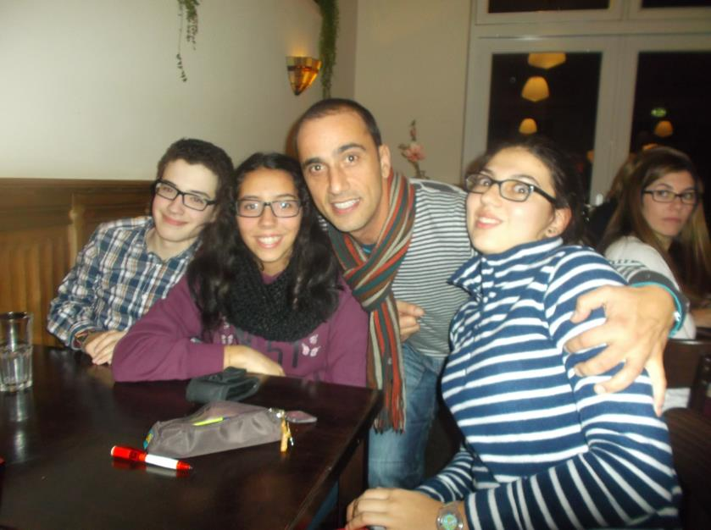
Welcoming dinner
We went to Bastion Hotel and at 7 pm we went with the other people involved in the project to a welcoming dinner.

Slide 8
Second day
First day of school ;)

Slide 9
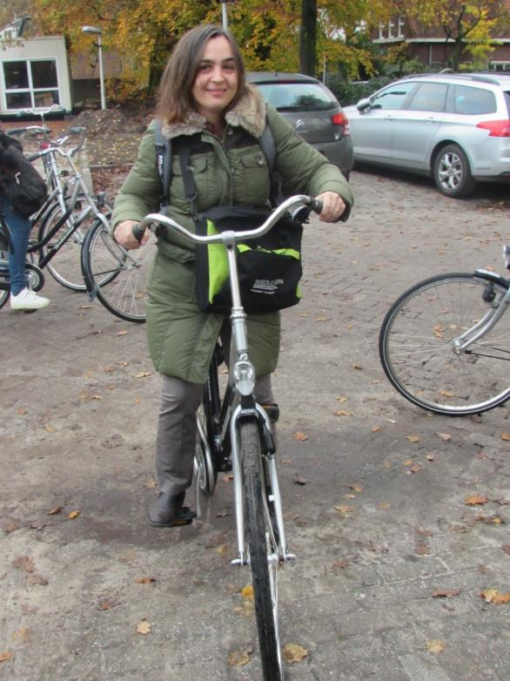
First, the bicycles
We woke up at 7 am to have breakfast at 7:30 am. We had to go to school by bicycle so the first thing we did was find one for each one of us.

Slide 10
That’s how you do it?...

Slide 11
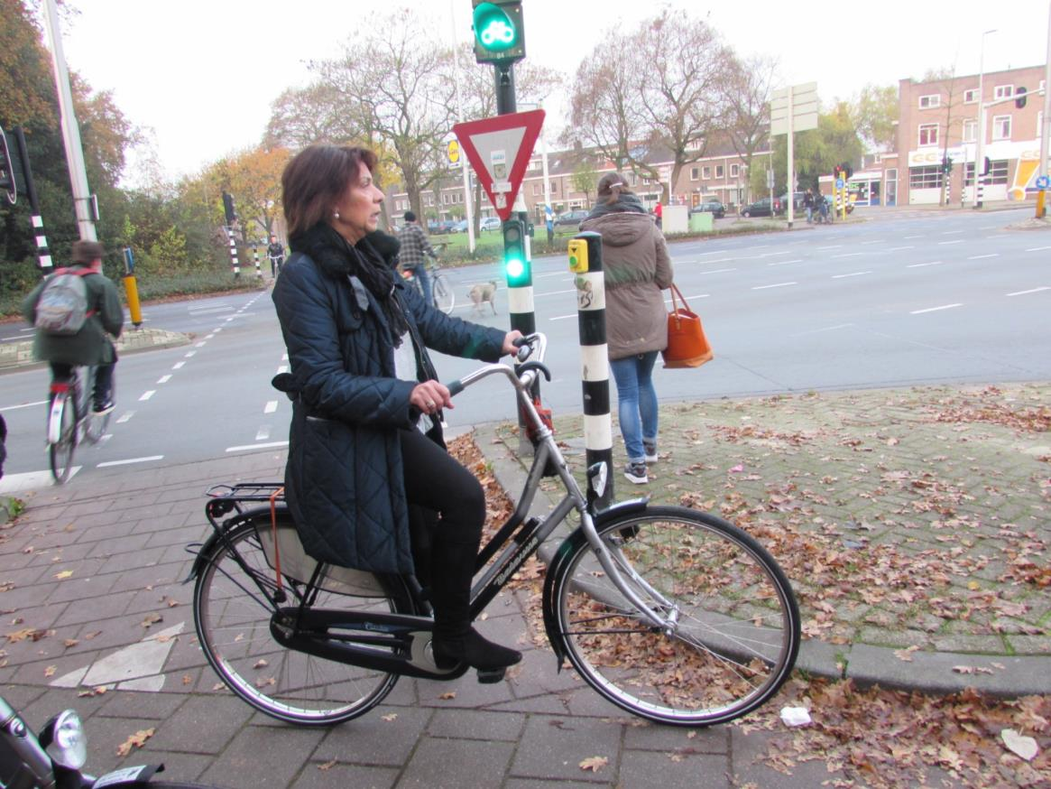
Then we drove ;)

Slide 12
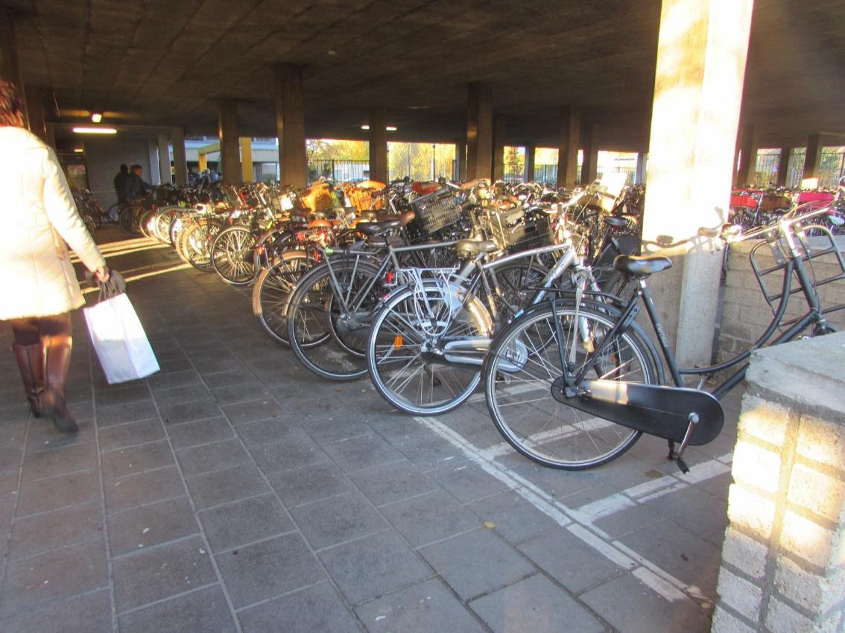
2Cobbenhagenlyceum
We got there and parked our bikes.

Slide 13
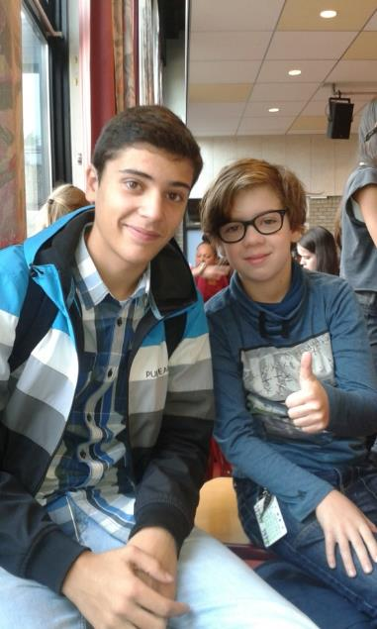
Our school day
We met all the people involved in the project and then we head out to meet our classmates for the week. In our first day we had Maths, Europe Lesson and History. We were integrated in a bilingual class. They have almost all their lessons in English.
There was a student assigned to each one of us.
João with Jop, the student assigned for him.

Slide 14
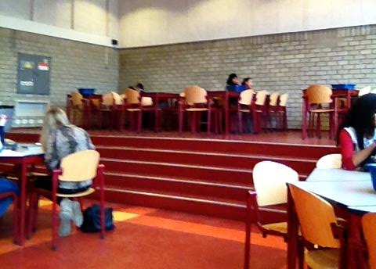
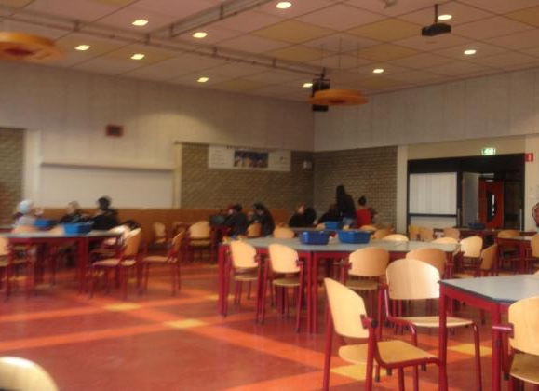
Aula
We had lunch in the school’s auditorium. In this school there isn’t a canteen. They don’t serve hot meals. You can buy your lunch in the school bar but most of the students take their lunch from home.

Slide 15
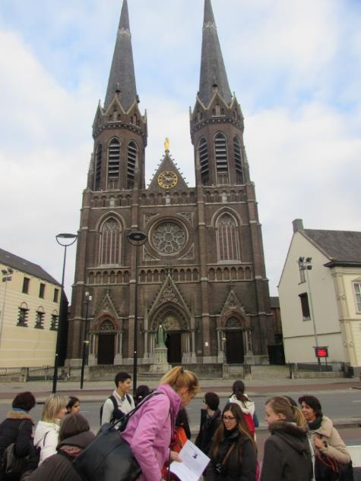
Downtown
After school we went to Tilburg’s downtown where we had a guided tour of the highlights of downtown.
This is St. Joseph’s Church. The church, which was designed by Hendrik van Tulder, was built between 1872 and 1889. This church is the fourth highest building in Tilburg. The main
organ as well as the choir organ in the church itself are national monuments.

Slide 16
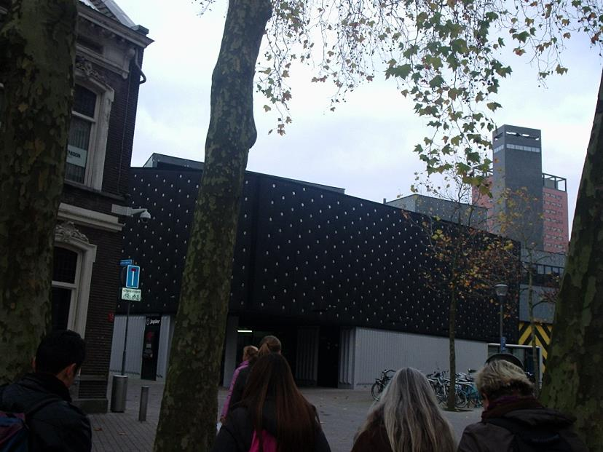
Pop Factory and Linen factories

Slide 17
THIRD DAY
Loonse en Drunese Duinense National Park

Slide 18
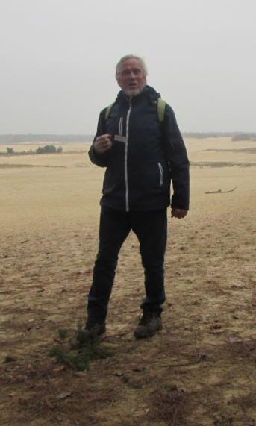
Loonsen en Drunese Duinese National Park
On Tuesday we had Biology, English, French and Physical Education. At the end of classes we went to the Loonse en Drunese Duinense National Park. We had a guided tour.

Slide 19
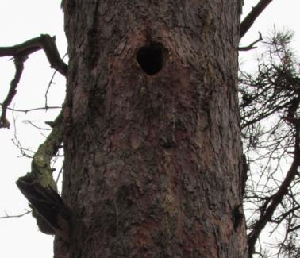
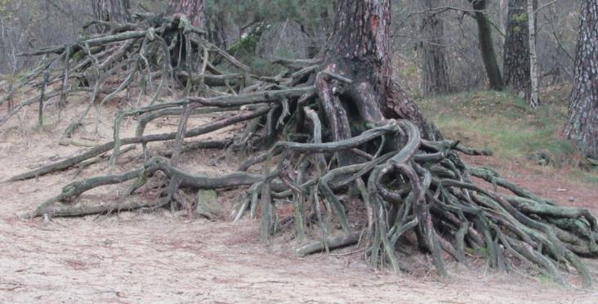
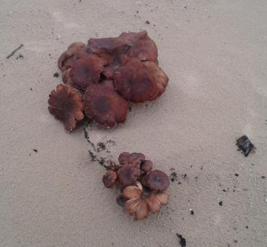
Loonsen en Drunese Duinese National Park
This Park is situated in the south of the Netherlands. It has 35 Km² and it preserves an area of temperate coniferous forest, dunes and wetland like swamps.

Slide 21
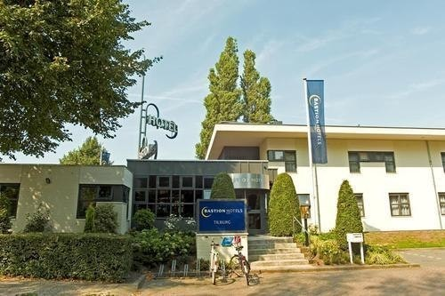
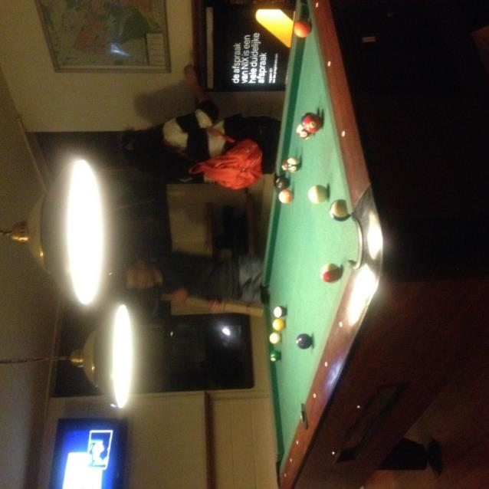
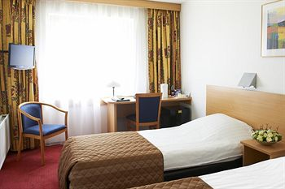
In the Hotel
We played a lot of snooker during that week.

Slide 22
Fourth DAY
The Efteling

Slide 23
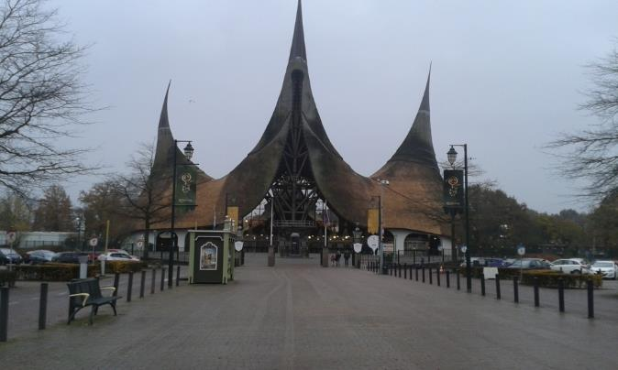
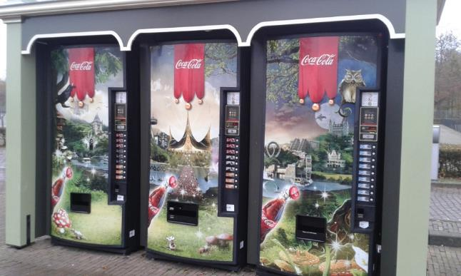
The Efteling
Efteling is the largest theme park in the Netherlands and one of the oldest theme parks in the world. It opened in 1952 and in 2013 they had 4.150.000 visitors.

Slide 24
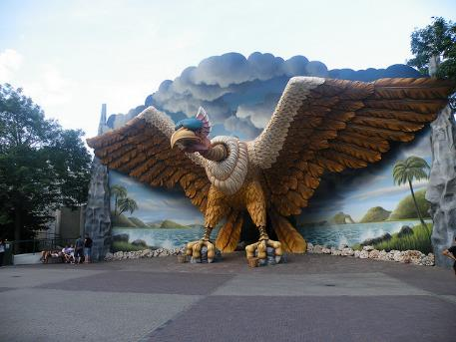
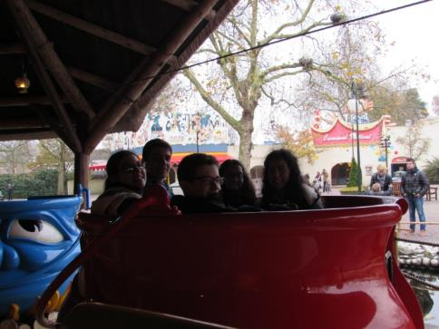
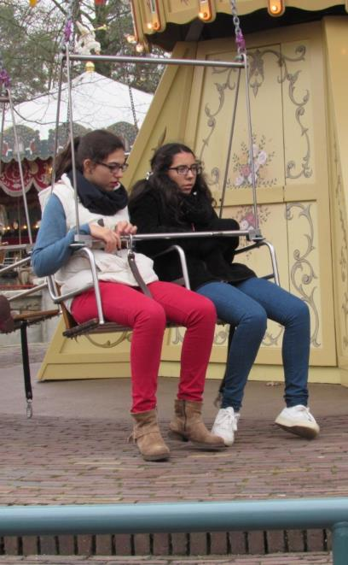
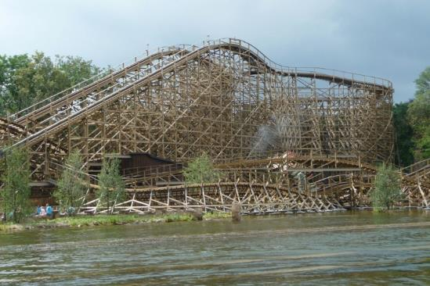
Park attractions we visited
Vogel Rok indoor rollercoaster
Monsieur Cannibale
Joris en de Draak

Slide 25
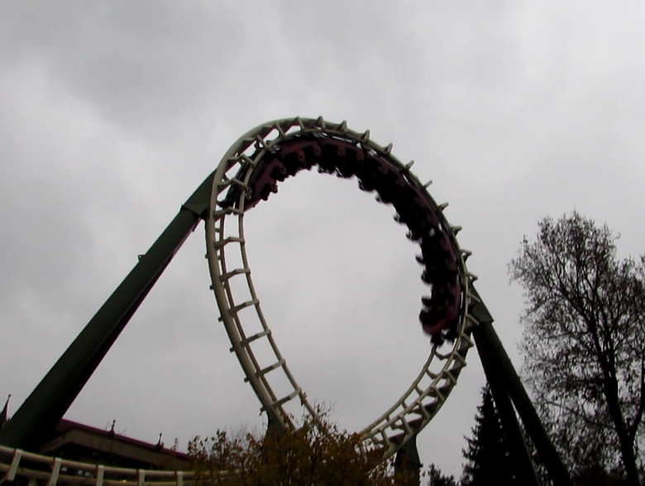
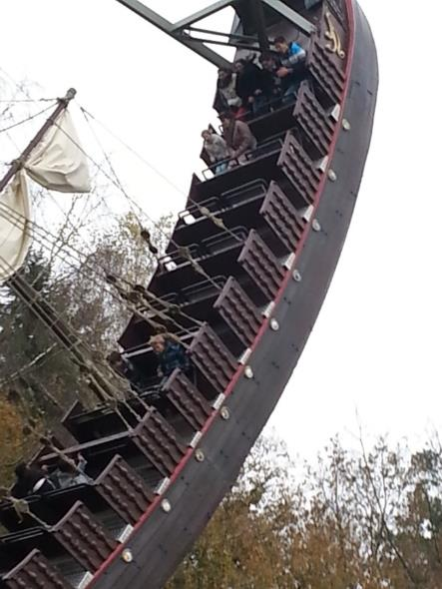
Park attractions we visited
Python
Halve Maen swinging ship

Slide 26
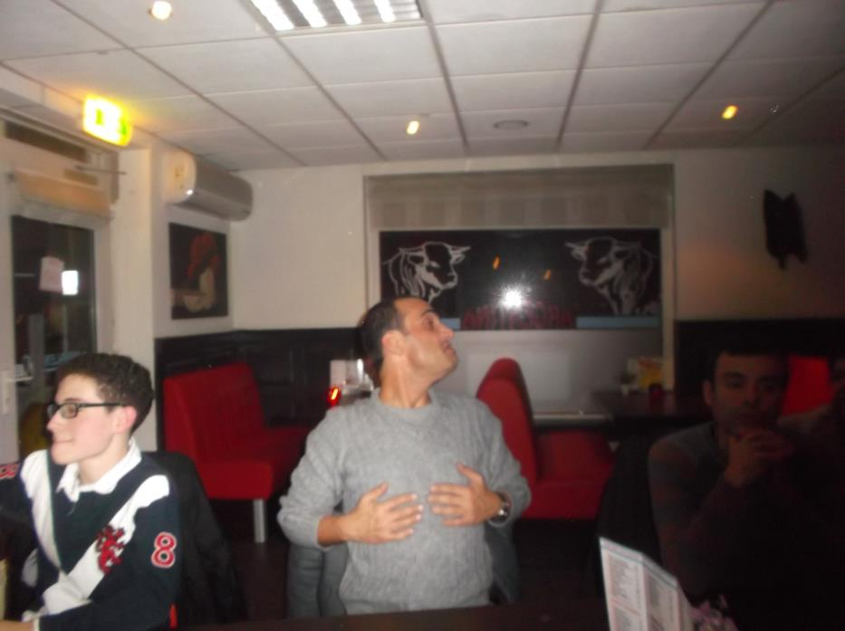
Dinner in the restaurant
Apparently teacher Carlos Reis liked the spare ribs very much ☺

Slide 27
Fifth day
Goodbye to Tilburg

Slide 28
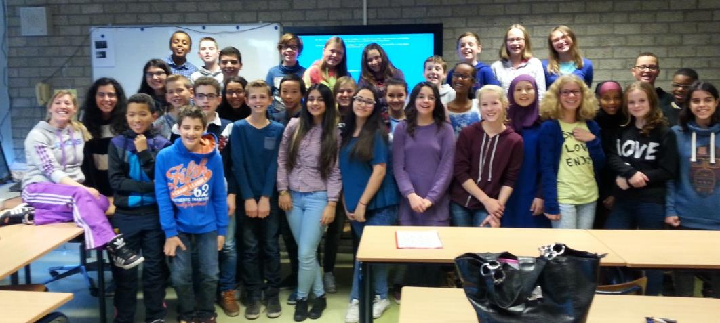
Last day of school ☹
We had Music, English, French, Science, Dutch, Maths and Europe Lesson. It was in this last lesson that we said goodbye to all of our classmates for the week.

Slide 29
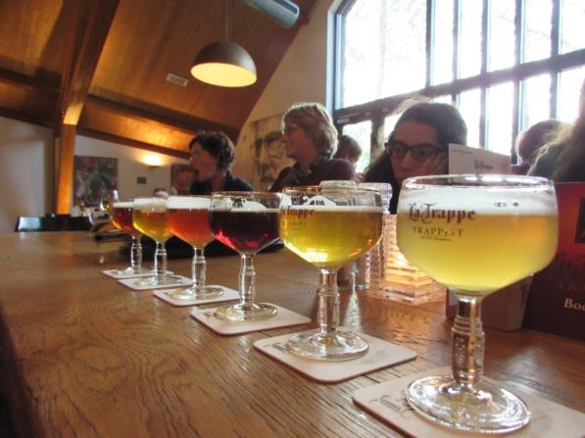
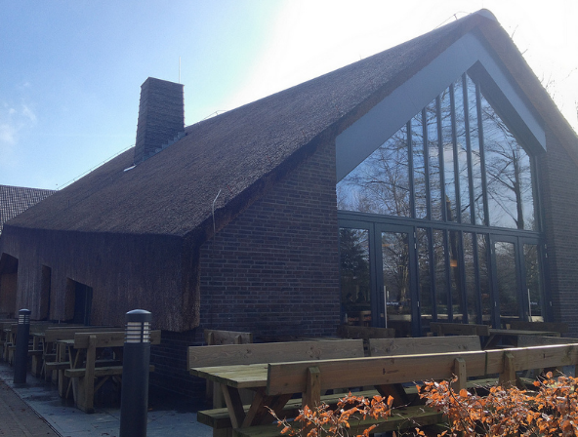
La Trappe
In the afternoon, after school, we went to a monastery and visited La Trappe. The teachers could taste dutch beer.

Slide 30
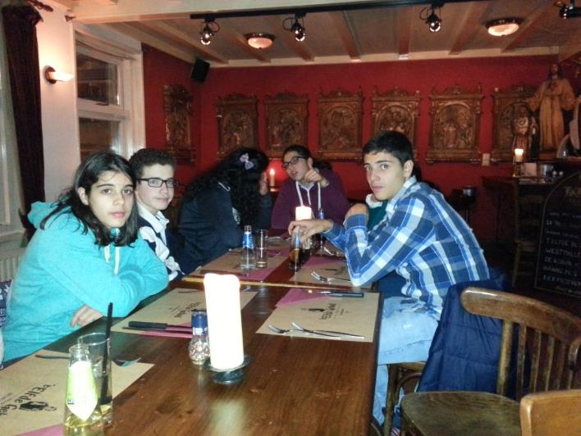
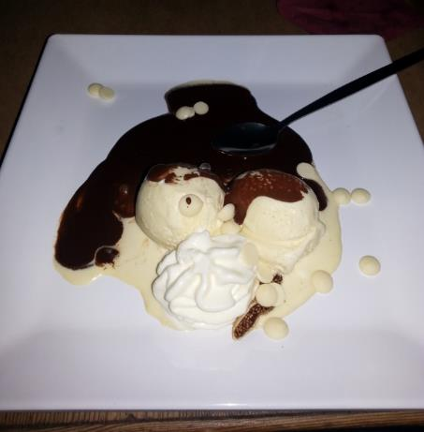
Goodbye dinner
In the evening we had a dinner in a restaurant with all the people involved in the project.
The dessert was great ☺

Slide 31
Sixth day
Amsterdam !!!

Slide 32
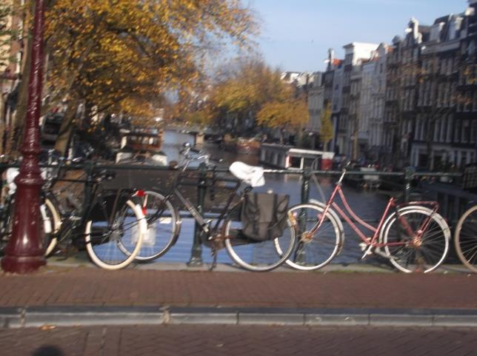
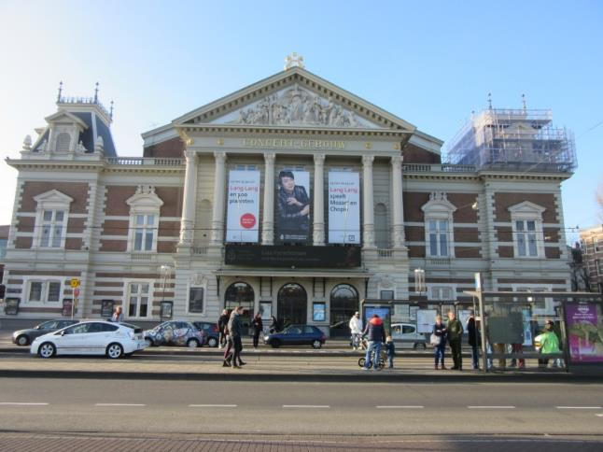
Walking around Amsterdam
We left Tilburg in the morning and went to Amsterdam. When we got there we left our bags in the hotel and head out to meet this city ☺.

Slide 33
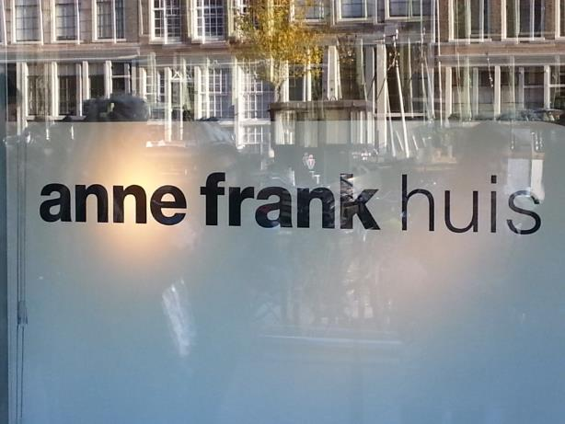
Anne Frank’s House
The first thing we visited was Anne Frank’s House. It is a historic house dedicated to Jewish wartime diarist Anne Frank. The museum opened in 3 May 1960. It preserves the hiding
place and has a permanent exhibition on the life and times of Anne Frank.

Slide 34
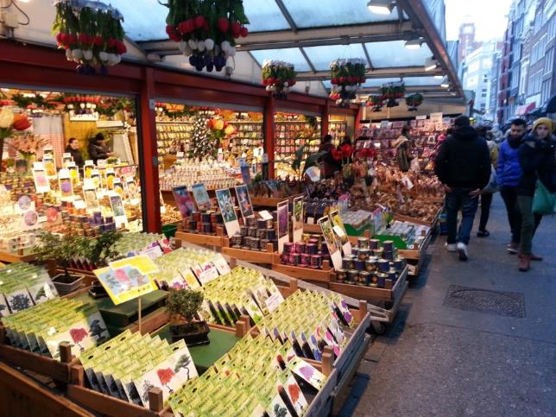
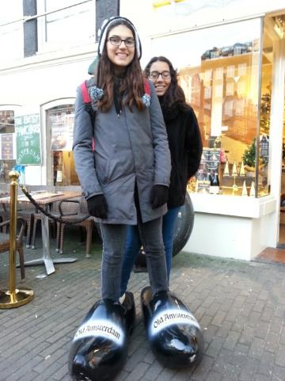
Flower Market
After lunch we went to the Flower Market and bought some souvenirs.

Slide 35
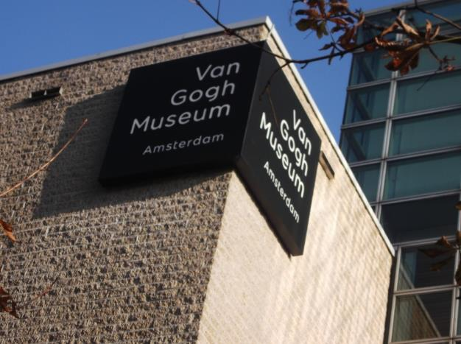
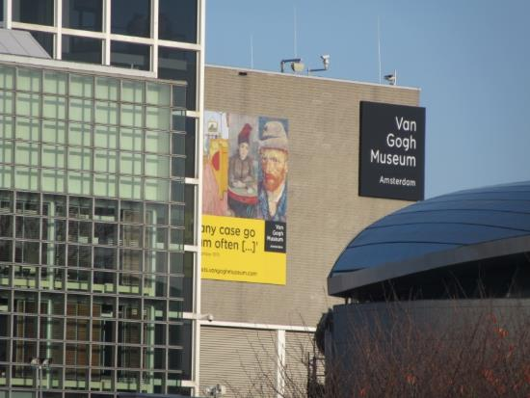
Van Gogh Museum
The last thing we visited was Van Gogh Museum. It’s an art museum dedicated to the works of Vincent Van Gogh. It opened in 3 June 1973.

Slide 36
Seventh day
Getting back to Portugal

Slide 37
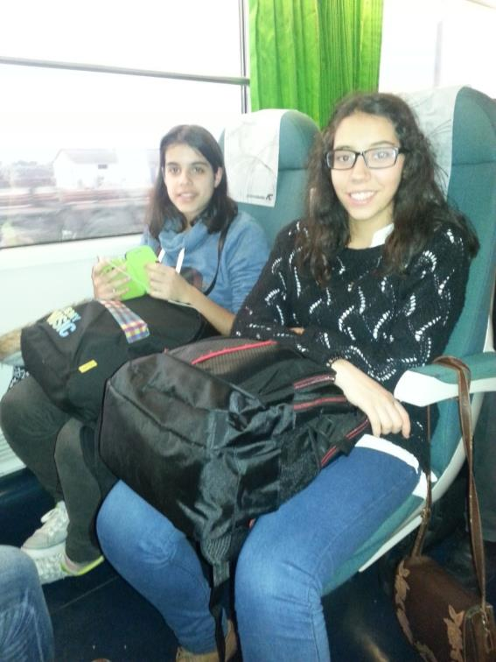
Coming Home
We came by plane to Lisbon’s airport and took the train to Coimbra. We were finally home… ☺

Slide 38
We will miss Holland ☺

