Slide 1
PALEKASTRO PRIMARY SCHOOL
Europe's Unique Regions - Our Personal Experience

Slide 2
Celebrating Christmas in Greece!
Some Christmas activities and tasks!
A presentation by Sixth(6) Class Students!

Slide 3
Notes:
Introducing Christmas Expressions- How many expressions do you know forChristmas and New Year?- Merry Christmas!- Happy Christmas- Happy New Year!- Merry Christmas and a Happy New Year!- Wishing you a prosperous New Year!- All the best for the coming year!- Seasons Greetings!- Can you think of any more seasonal expressions?

Slide 4
Notes:
-How much do you know about Christmas? - Can you think of any local or international Christmas customs and traditions?- Can you answer the following questions about Christmas traditions all over the world?- In the Christmas vocabulary which follows, how many words do you know?

Slide 5
Notes:
So how much do you know about Christmas?

Slide 6
Notes:
Answer keyhttp://a4esl.org/q/h/vc-traditions-lb.html

Slide 7
Notes:
Christmas Vocabulary introduced(alphabetically) http://www.englishclub.com/vocabulary/festivals-christmas.htm (4/12/2012)

Slide 8
Notes:
Activity with Vocabulary words Match the columns:

Slide 9
Notes:
Answer Key

Slide 10
Notes:
Activity: Create your own wordsearch using the following words

Slide 11
Notes:
http://www.superteacherworksheets.com/christmas/christmas- scramble2_WMBTD.pdf (4/12/2012)

Slide 12
Notes:
Writing a Christmas PoemInstructions:- Get children to think about and brainstorm things that remind them of Christmas.- Then ask them to write a two-verse poem, verse one starting with the words &Outside at Christmas....& followed by several descriptive sentences, and the second verse starting &Inside at Christmas...& and followed by more sentences.http://www.teachingideas.co.uk/themes/christmas/christma (4/12/2012)

Slide 13
Notes:
Tips for poem writing:Students can try and link their linesbetween verses to show contrast, e.g.(outside at Christmas) trees are bareand branches thin/animals search forfood in the cold and in the second verse(inside at Christmas) trees are ladenwith baubles and lights/people areeating mince pies around the fire etc.

Slide 14
Notes:
Example of Christmaspoems with activities: -What kitten sees -Long, long ago

Slide 15
Notes:
Long Long Ago  Christmas poem! Author Unknownhttp://www.teachingideas.co.uk/themes/christmas/_files/nightbef orechristmasassembly.pdf (4/12/2012)Winds thro the olive treesSoftly did blow,Round little BethlehemLong, long ago.Sheep on the hillside layWhiter than snow;Shepherds were watching them,Long, long ago.Then from the happy sky,Angels bent low,Singin their songs of joy,Long, long ago.For in a manger bed,Cradled we know,Christ came to Bethlehem,Long, long ago.

Slide 16
Notes:
Can you write your own Christmas poem now?-What is the Long, long ago poemabout?-Who is going to read your poem?-Which words related to Christmas doyou want to use?

Slide 17
Notes:
Before you take a look at the acrosticpoem below, try to answer the questions:- Do you know what an acrostic poem is? Can you guess?- Are there any seasonal/festive words you would like to use in order to write an acrostic poem?- Would you prefer to write an acrostic poem alone or as part of a group?- Can you think of some of the features of an acrostic poem?- Have you ever written an acrostic poem in English or in your mother tongue?

Slide 18
Notes:
Can you write your own Christmasacrostic poem now?You can get help from the following Christmas vocabulary word list GOOD LUCK!

Slide 19
Notes:
Christmas Vocabulary Word Listhttp://www.myvocabulary.com/word-list/christmas-vocabulary/ (4/12/2012)

Slide 20
Notes:
Writing task: Write to Santa!Compose a letter to Santa andpersonalize it with information aboutyourself.Tip: You can have a discussion session firstto decide what kind of questions studentswant answers to.

Slide 21
Notes:
A thoughtful Powerpoint presentationfollows encouraging children to think ofothers at this time of year.Contributed by Lisa Daniels.http://www.teachingideas.co.uk/themes/christmas/ind ex.htm (4/12/2012)

Slide 22
Notes:
Our ChristingleToday we have made a Christingle toremind us that Jesus is The Light ofthe World. Here are some images tohelp us focus our prayers today. Aftereach prayer read by your teacher we allsay:Jesus shine your light.

Slide 23
Notes:
The War In Iraq Lord we pray that you will help to restore peace in Iraq soon. Jesus shine your light.

Slide 24
Notes:
Poverty Lord, around the world there are so many people who have no homes or money. Please help them this Christmas time. Amen.Jesus shine your light.

Slide 25
Notes:
Hunger Lord, were so lucky that we have plenty to eat. Please help us to remember all those children in Africa who will die this year because they have nothing to eat. Amen. Jesus shine your light.

Slide 26
Notes:
Your Prayers Think about somebody you know that needs help from Jesus at the moment. Maybe you know someone who is poorly or upset. Ask Jesus to shine His light into that situation. You can take your Christingle home tonight. When you look at it remember that Jesus is always with you,shining His light into your life, helping to show the way.

Slide 27
Notes:
- Can you write your own prayersfor Christmas? Think of aperson/relative/family/country etc. in need and write down a prayer!

Slide 28
Notes:
Reading Comprehension Christmas ActivitiesRead the following textscarefully and answer thequestions:

Slide 29
Notes:
Famous Greek Christmas recipes

Slide 30
Notes:
Melomakarona (honey cookies with walnuts)- INGREDIENTS - Preheat oven to 200c- 2 cups oil - Beat oil well with mixer, then add the sugar, both zests, orange- 1 cup sugar juice, semolina, and then, a little- 1 cup orange juice at a time, the flour mixed with- 1 cup fine semolina the baking soda.- 1 kilo soft flour - Form the dough into small shapes, as the pastries will get- 1 Â½ teaspoons baking soda quite big while baking. Make sure- Lemon and Orange zest the oven is hot before baking, otherwise the pastries will- Simple syrup: (In a pot, mix flatten. Bake for about 30 together 1 cup each of water, minutes until pastries are firm honey and sugar and bring to and golden brown. boil while stirring - When completely cooled, arrange constantly.) in rows in a pan and pour warm- Crushed walnuts syrup over them. Sprinkle with crushed walnuts.

Slide 31
Notes:
Fill in the blanks in the following recipe: - Melomakarona INGREDIENTS 2 cups oil 1 cup sugar 1 cup orange juice 1 cup fine 1 kilo soft .. 1 Â½ teaspoons baking soda Lemon and Orange zest Simple syrup: (In a pot, mix together 1 cup each of water, honey and sugar and bring to boil while stirring constantly.) Crushed

Slide 32
Notes:
http://www.polkadotbride.com/2012/04/greek-easter- melomakarona-recipe/ (4/12/2012)

Slide 33
Notes:
KourampiedesINGREDIENTS: - Preheat oven to medium (175c).- 2 kilos soft flour - Whiten the butter by- 1 kilo butter beating by hand for Â½ hour. Add the sugar, cognac,- 300 grams powdered almonds and finally the flour, sugar mixed with the baking soda. Continue to beat until all- 300 grams crushed ingredients are well mixed. roasted almonds - Mold into the familiar- 1 small glass cognac shapes of theÂ kourambiethesÂ and place- 1 teaspoon baking soda on a cookie sheet. Bake for 20 minutes until golden.- Rosewater Remove from oven and immediately sprinkle with rosewater, then roll in the powder sugar.

Slide 34
Notes:
Fill in the blanks in the followingrecipe:Kourampiedes INGREDIENTS:- 2 kilos soft flour- 1 kilo - 300 grams - 300 grams crushed roasted .- 1 small glass cognac- 1 teaspoon baking soda- Rose

Slide 35
Notes:
Kataifi (dessert) INGREDIENTS - 1 lb. kataifi dough (shreddedÂ phylloÂ dough) - 1 lb. chopped walnuts - 1/2 cup sugar - 1 tsp.Â cinnamon - 1/2 tsp. ground cloves - 1 lb. butterSyrup: - 1/2 lb. honey - 3 cups sugar - 3 cups water - 2 T.Â lemonÂ juice

Slide 39
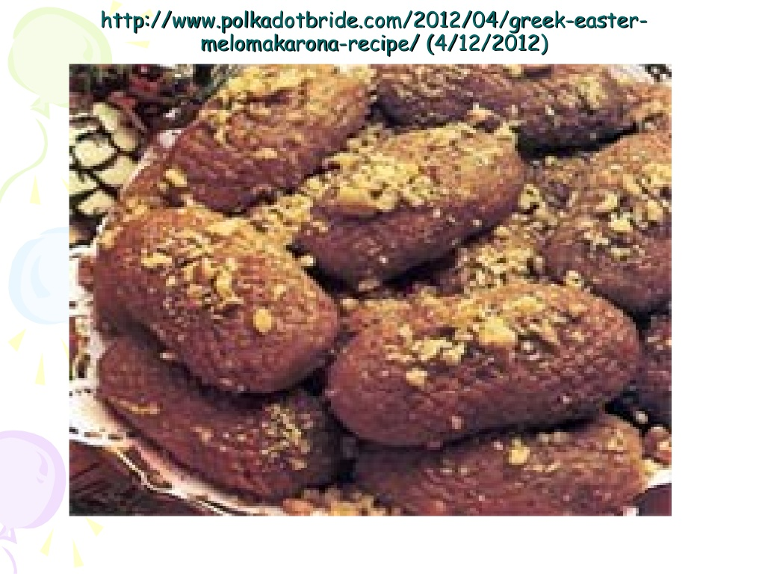

Slide 42
